Slide 1
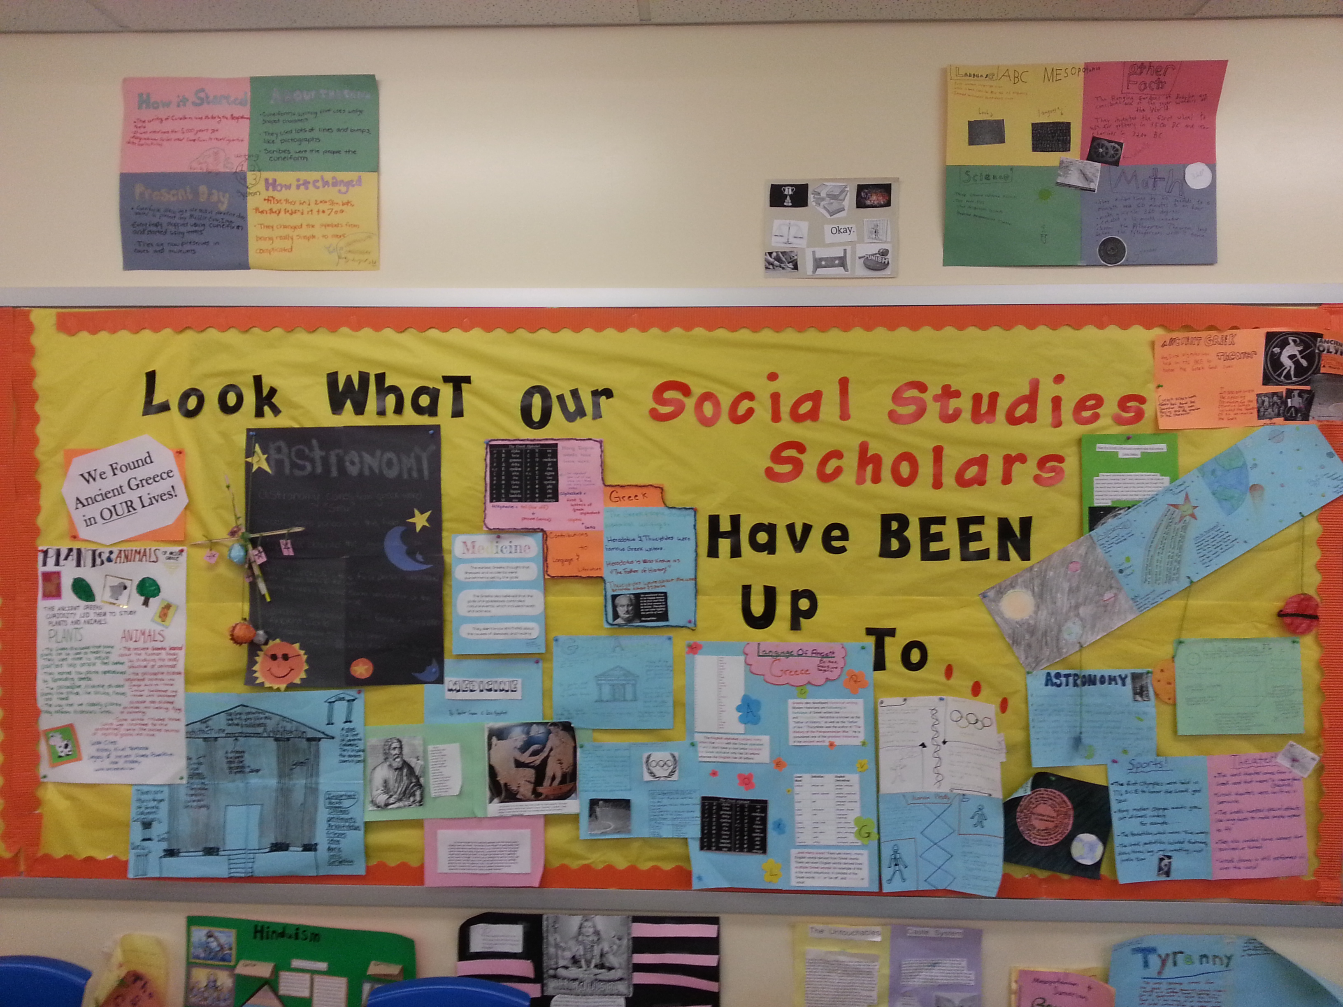
Welcome to 7th Grade Social Studies!
Portland Middle School
2015-2016
Ms. Harris

Slide 2
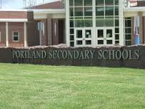
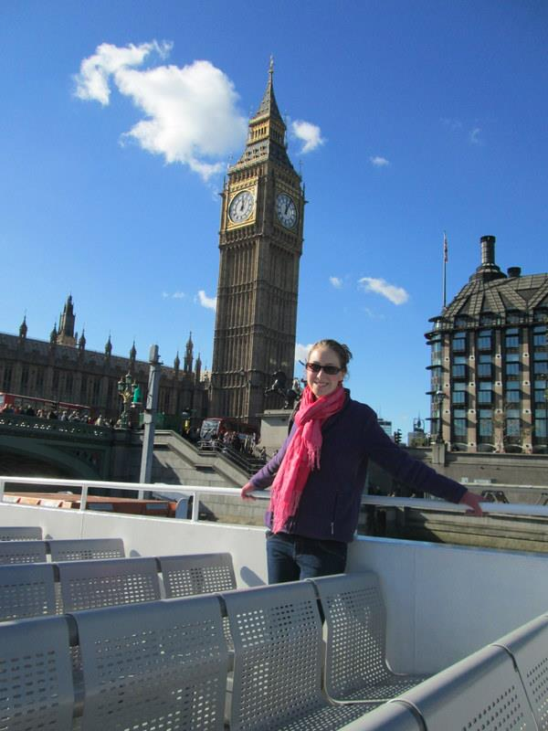
Who Am I?

Slide 3
What is “history”?

Slide 4
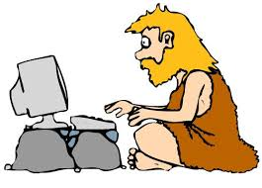
History is…
The study of past events, particularly relating to human affairs.

Slide 5
Today’s Agenda
Do Now! → What is history?
Review grading policies/syllabus
Website: www.msharrissocialstudies.weebly.com
Expectations Contract
What does history look like?

Slide 6
What does history look like?

Slide 7
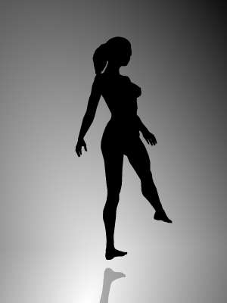
Thinking About Perspective
Spinning Dancer

Slide 8
What is PERSPECTIVE?

Slide 9
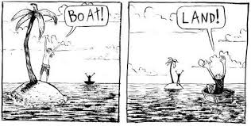
Perspective is…
Point of View

Slide 10
Back to the Future II (1989)
How close to reality were the film writers in their representation of the “distant future” – 2015?

Slide 11
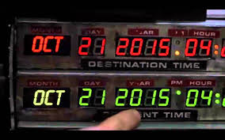
CNN Report

Slide 12
AT&T Ads (1993)

