Slide 1
Preparing for Our Archaeology Workshop & Exploring the Purpose of Government
Thursday, September 3rd, 2015

Slide 2
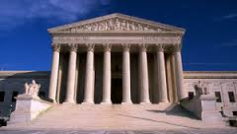
What is the purpose of GOVERNMENT?

Slide 3
Rules
Who makes the rules at PMS?
What is the purpose of laws/rule?

Slide 4
What is a DEMOCRACY?

Slide 5
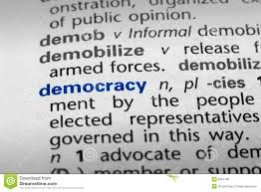
A DEMOCRACY is…
Government by the people.

Slide 6
At PMS, YOU are “the People”!
We have a student government called the PMS Student Council. The Student Council plans social and community service events, spirit activities, and communicates the student voice to the teachers and administrators.

Slide 7
Vocabulary Used by ARCHAEOLOGISTS

Slide 8
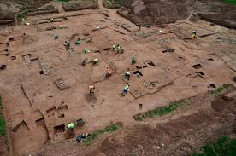
SITE
An archaeological site is a place in which evidence of past activity has been preserved.

Slide 9
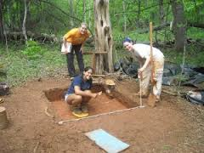
QUADRAT
A small rectangular plot of land used for sampling archaeological archaeological artifacts

Slide 10
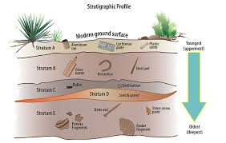
STRATIGRAPHY
Layers of the earth

Slide 11
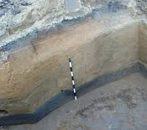
CONTEXT
The specific layer of earth in which items from a similar time period are found.

Slide 12
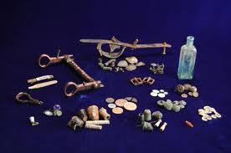
ASSEMBLAGE
A group of artifacts found in the same context (or layer of the earth).

