Slide 1
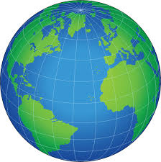
Mapping Our World
Exploring Map Projections

Slide 2
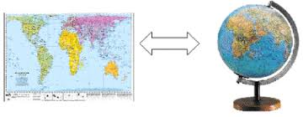
Do Now!
How does the process of mapping a three-dimensional world on a two-dimensional map affect the accuracy of the image?

Slide 3
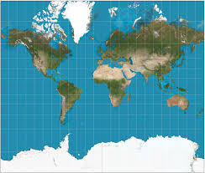
Mercator Projection
The Mercator projection was developed more than 400 years ago. This projection is great for navigational use (sailors and pilots) because it shows true direction, but it distorts the land in the high latitudes.
*HINT: Look at Greenland and Africa. Are their sizes relative portrayed accurately?*

Slide 4
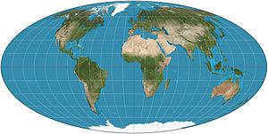
Equal Area Projection
An equal area projection values accuracy of proportion (size of one land mass in relation to another) over accuracy of angle and shape.

Slide 5
So, what’s the difference?
vs.

Slide 6
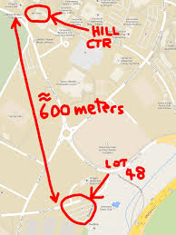
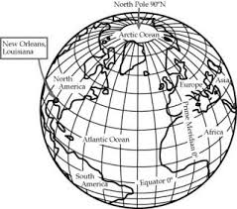
How can we locate places if maps are different?
In order to locate places on different maps, we use absolute location and relative location.

Slide 7
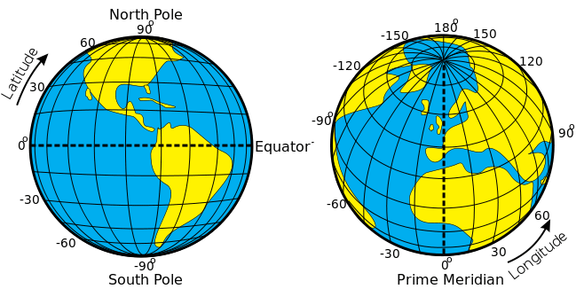
Absolute Location
Absolute location describes the location of a place based on a fixed point on earth. The most common way is to identify the location using coordinates such as latitude and longitude. A specific address would also be an example of absolute location (i.e. 93 High Street Portland, Connecticut).

Slide 8
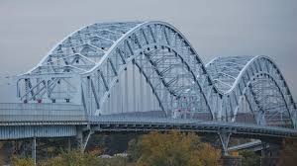
Relative Location
Relative location is the location of something in comparison to the location of something else. For example, if I said, "My house is near the the Arrigoni Bridge," that's a relative location. I'm describing where my house is located relative to the bridge.

Slide 9
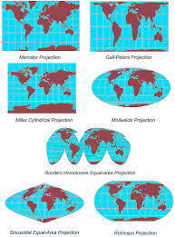
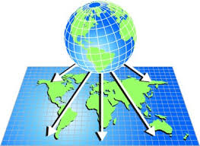
Let’s Try it! Making a Map Projection

Slide 10
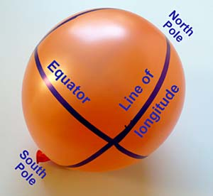
Step #1
Inflate the balloon about halfway (approximately 6 inches in diameter). Using your marker, draw a North Pole (N), South Pole (S), equator, and line of longitude.

Slide 11
Step #2
Draw a total of 26 equally sized circles on the balloon using your bottle cap. For each circle, place the bottle cap on the balloon and trace around it with permanent marker. Start with one circle centered on an intersection of the equator and a line of longitude. Repeat for the three other lines of longitude.
Add four more circles on the equator that are equally spaced between the four circles already there.
Add a circle on the North Pole (top of the balloon) and the South Pole (area with the knot).
Add eight circles in the northern hemisphere, about midway between the equator and the pole, with two circles between each pair of lines of longitude. Note that these circles are located on the same line of latitude.
Repeat for the southern hemisphere.

Slide 12
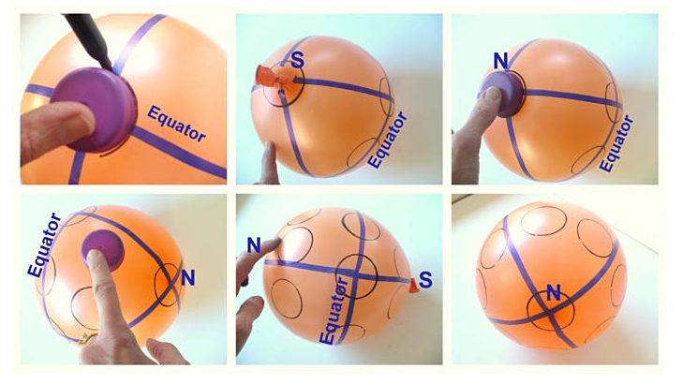

Slide 13
Let’s Think!
Look at your balloon; how are the circles distributed? Are the circles on the equator equally spaced? How about the circles between the equator and each pole? Note that these circles are on the same line of latitude as well.
Are all of the circles equally spaced?
Look at a circle on an intersection of the equator and one of the lines of longitude. How would you describe the direction from this point to the circles that are closest to it in the northern and the southern hemispheres in terms of north, northeast, etc.?

Slide 14
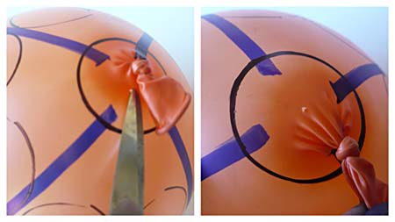
Step #3: Deflating Your Balloon
Use scissors to snip a tiny hole in the balloon, close to the knot. This will slowly deflate (not pop!) the balloon.
DO NOT POP YOUR BALLOON OR YOU WILL HAVE TO START OVER!

Slide 15
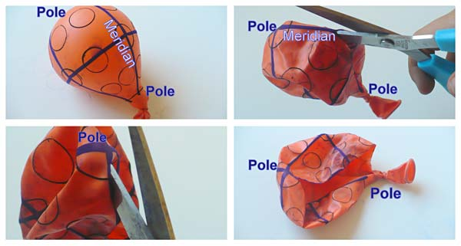
Step #4
Once the balloon is deflated, cut it open along a line of longitude from the South Pole (the knot) to the North Pole, but stop a little before the very top of the balloon. Cutting over the very top increases the risk of the balloon ripping when it is stretched out in later steps.

Slide 16
Step #5
Put the cardboard in front of you on your work area. Place the push pins within reach. Work together and stretch out the balloon to be flat and as close to rectangular in shape as possible. One person can hold one side, while the other can hold the other side of the balloon. Try to get the equator straight and the lines of longitude as straight as possible. Note: Do not stretch the balloon too much, as this could rip the balloon. How do the circles change in form and size as you stretch the balloon?
Why would you stretch the balloon into a rectangular shape?
Why do you think you should keep the equator and the lines of longitude straight in a projection?

Slide 17
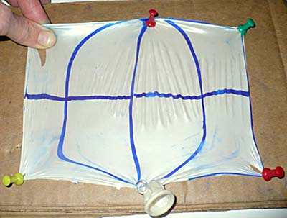
CAUTION: Be sure to put the push pins in slanted slightly outward (away from the balloon), as shown in the figure below. Push pins that are pointing straight down or with the clear/silver tips pointing inward might shoot out due to the tension in the balloon, causing a hazard.

Slide 18
Thinking About Our Results
Look at your flat map, especially the size and distance of the circles. Are the circles all still the same size? If not, can you find regions on your map where they are? Remember, all circles were the same size on the globe.
Are the circles still the same distance from each other? Remember, the circles on the equator were equidistant from each other; so were the circles between the equator and each pole. Also, the circles in the northern and southern hemispheres were drawn midway between the equator and each pole. Is this still the case on your map?
Look at your flat map again, now concentrating on the shapes of the circles. Do all of the circles still look like circles?
Do your observations indicate distortions in your map? Remember that you started with equal circles.

